Slide 1

INFO 6150 PRESENTATION GROUP
Healthify
Shams Alam Naimi 1029443
Anuja Suryawanshi 1383812
Girija Dhawale 1873112
Yash Kumar 1080365

Slide 2

Introduction
HIGHLIGHTS AND INSIGHTS
Healthify is a web-app for Nutritionists and diet enthusiasts.
Patients can get be assigned to a team of highly qualified medical professionals for their diet related concerns.
Doctors can make a patient specific note according to their expertise.

Slide 3



Problem Statement
Understandably medical information is private, we ensure end-to-end role specific privacy.
This is done in a way that individuals with different authorizations will use the app differently.
To emphasize that we have demonstrated 3 role accesses, restricting one role from the other at every point.

Slide 4


Technologies Implemented
Healthify is a full stack app, which uses MERN Stack.
FRAMEWORK: Express.js, ES6
MIDDLEWARE: Node.js & Express.js
Session Management: JsonWebToken
Back end: MongoDB
Styling: Bootstrap, CSS, FontAwesome
Logo and Images: Google
Website Styling: Bootstrap & CSS

Slide 5
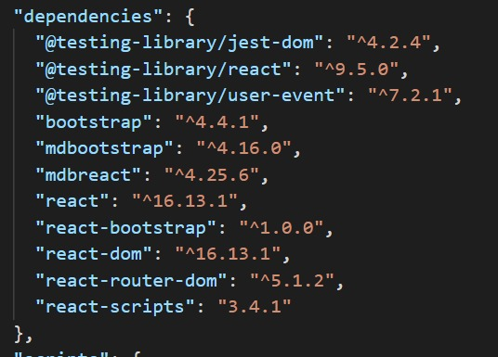
React-App Dependencies
bootstrap
mdbootstrap
mdbreact
react
react-bootstrap
react-dom
react-router-dom
react-scripts

Slide 6
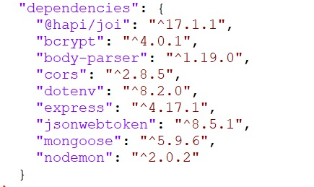
Server side Dependencies
@hapi/joi
bcrypt
Body-parser
cors
dotenv
express
jsonwebtoken
mongoose
nodemon

Slide 7
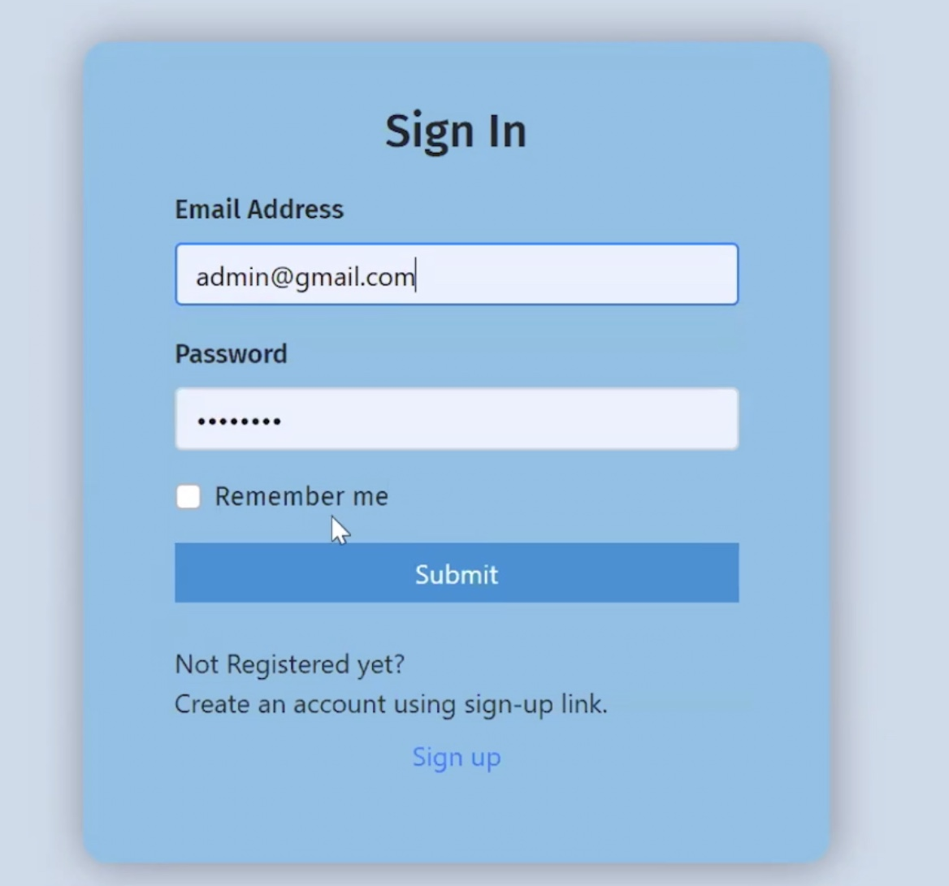
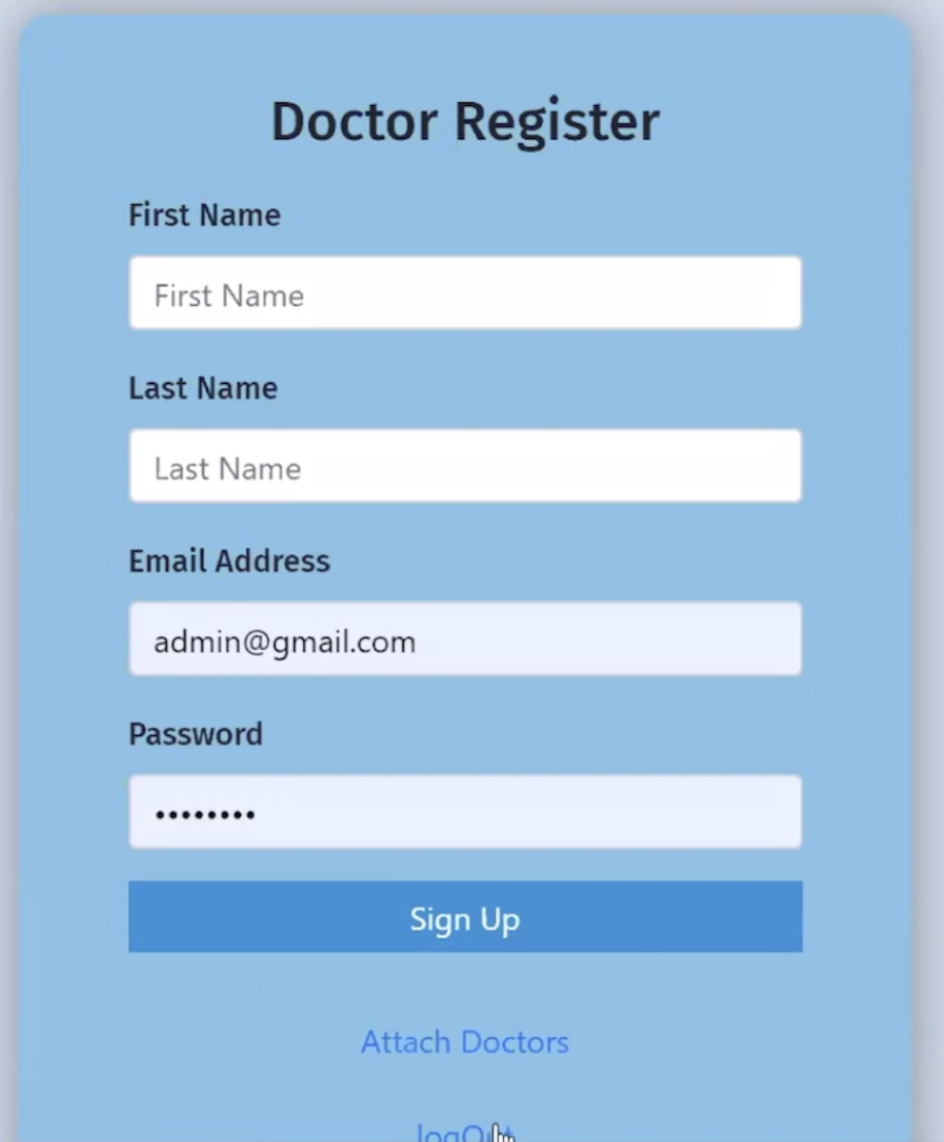
Sign In Page
Doctor’s Registration Page

Slide 8
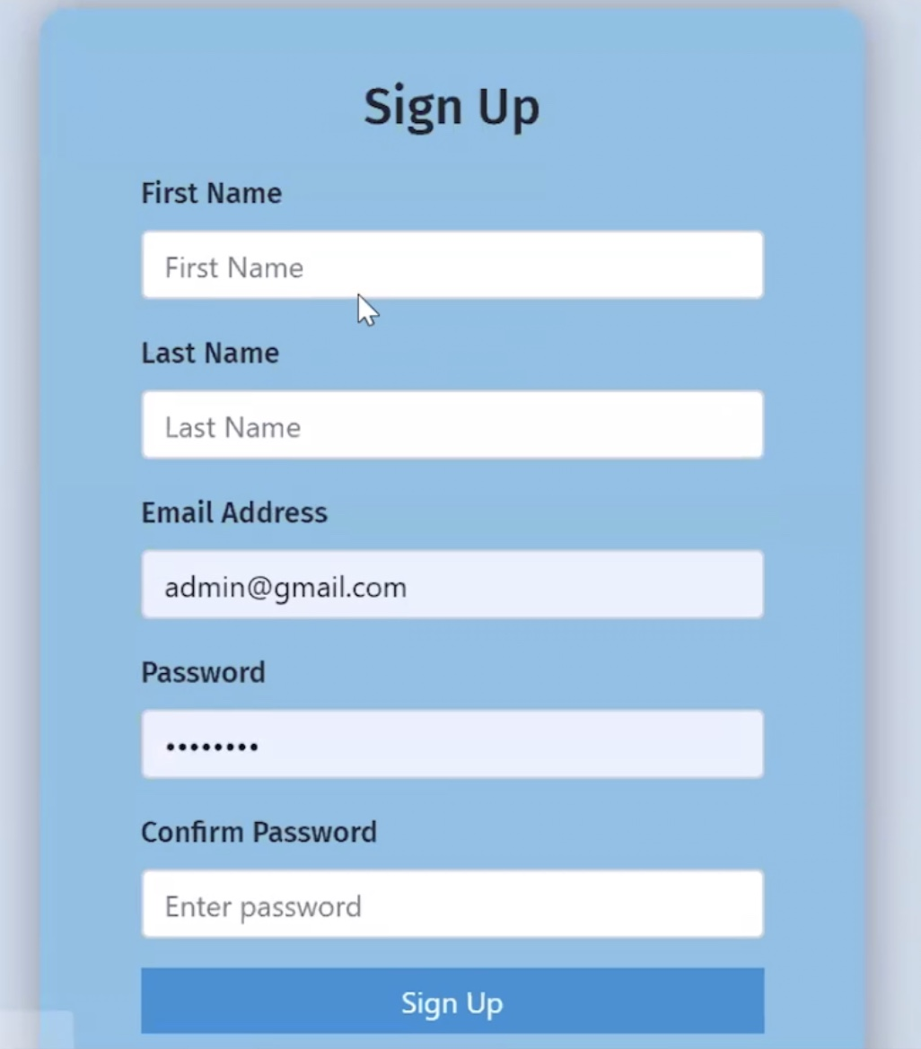
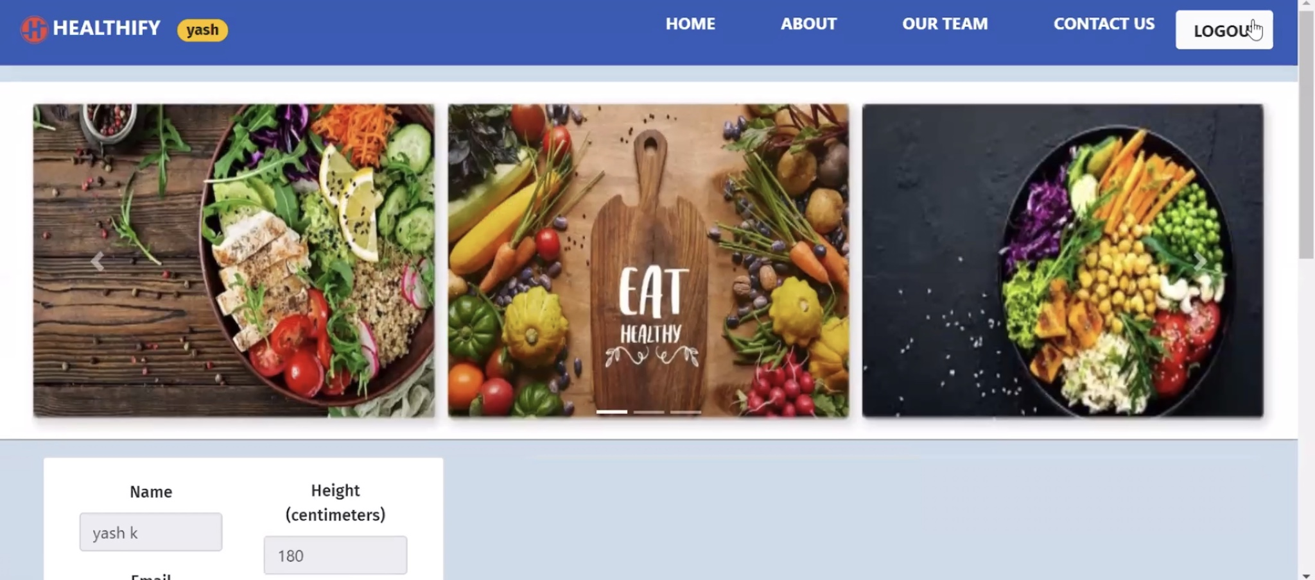
Sign Up Page
Home Page

Slide 9
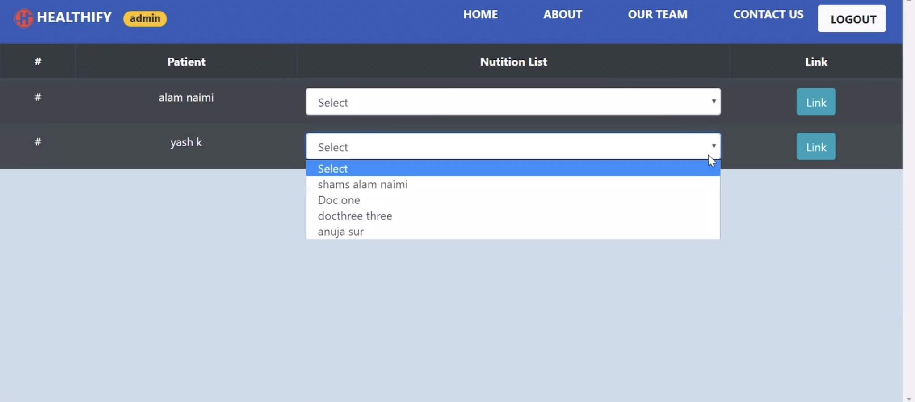
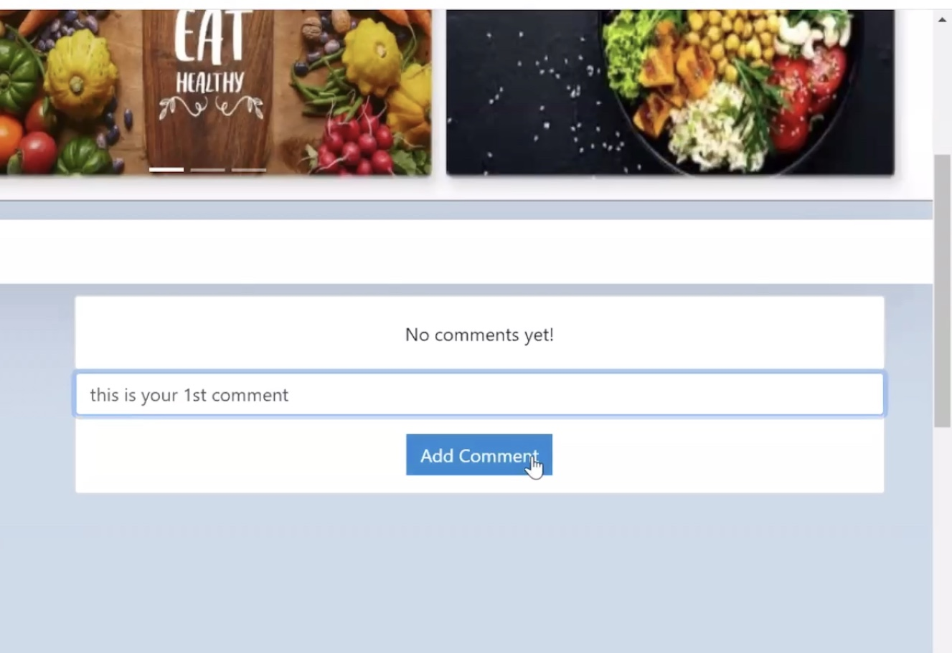
Assignment of Doctor
Comment Area

Slide 10
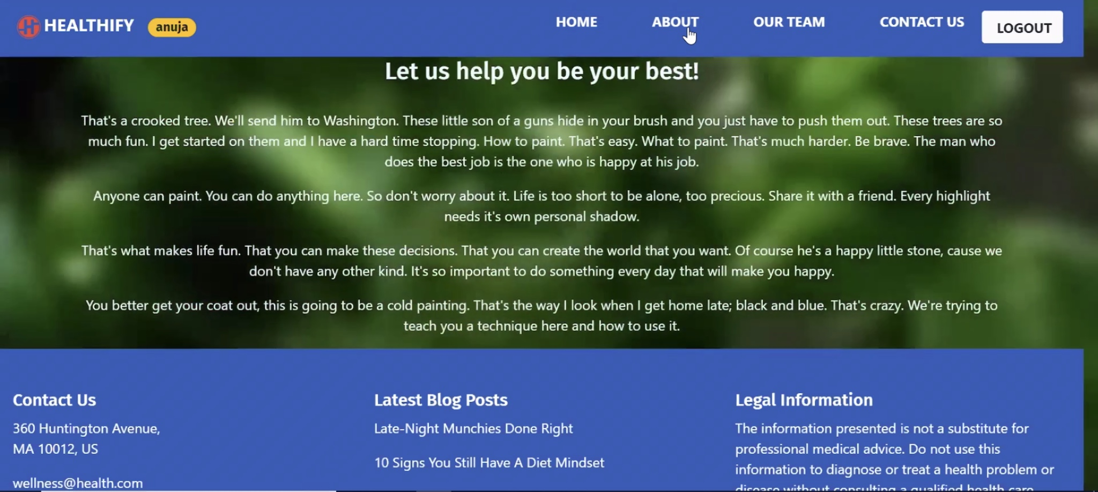
About Us

Slide 11
Thank you for your time!

